Slide 1
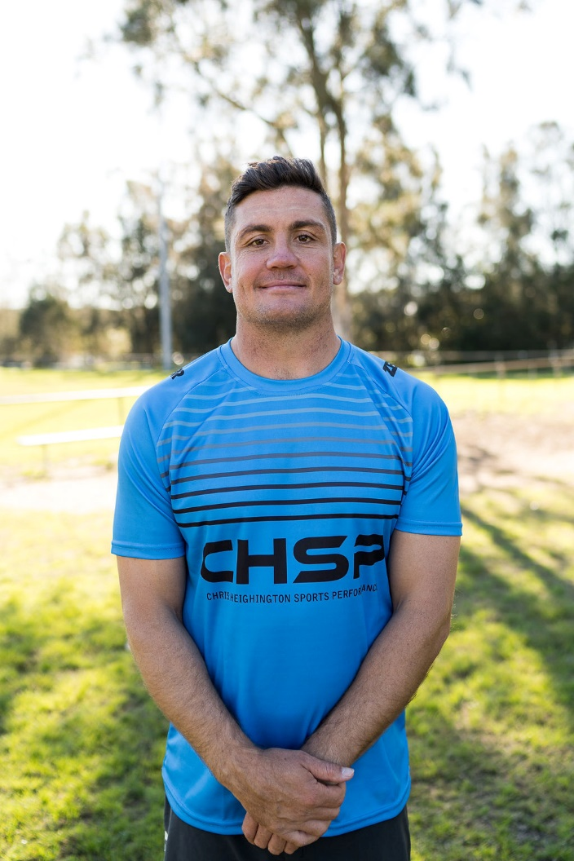
CHRIS HEIGHINGTON SPORTS PERFORMANCE (CHSP)
CHSP are taking EXPRESSION OF INTEREST for an exciting new program offered exclusively to KINCUMBER COLTS JUNIORS U10’S – U17’S players
CHSP SPEED, AGILITY AND CONDITIONING PROGRAM
This program will introduce KINCUMBER COLTS players to efficient movement patterns which will help develop speed, strength and agility and translate into improved player performance.
This eight week per term program will be dedicated to:
Conditioning training drills
Speed endurance drills that will help players maintain a higher work rate for longer
Develop game speed and cover more ground on the field
Learn simple techniques for first step quickness and reactive speed
Learn the most important pattern for optimal movement skill and injury prevention
Maximising cutting and faking skills to separate them from their opponents
Improve footwork for cutting and decelerating that reduces the risk of ankle and knee injuries
This program will be offered for School terms 2 and 3 (age groups & dates TBC) at Mackillop Oval.
Spots are limited to x16 player groups to ensure maximum attention 1:16 coach ratio.
Cost $200 per player, per term (includes 8 x 45min group training sessions).
Be a part of the CHSP team and send your expression of interest to chris@chrisheighington.com.au.
Further information will follow and first spots will be offered to players who have expressed their interest first.

